Slide 1
ONLINE MOBILE BALANCE FLEXILOAD SYSTEM
University of Asia Pacific Department of CSE
Md.Rafiqul Islam
ID:15101059

Slide 2
Contents
Abstract
Purpose
Advantages
Disadvantages

Slide 3
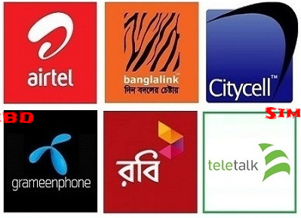
Abstract
Online Business system is a process a person sitting on his/her chair in front of a computer can access all the facilities of the Internet to buy or sell the products. So Online Flexi load System is a best example where we can load our mobile balance whenever we want.
Here is a picture of Ecommerce site. Though in Bangladesh people are using different categories of sim cards like…

Slide 4
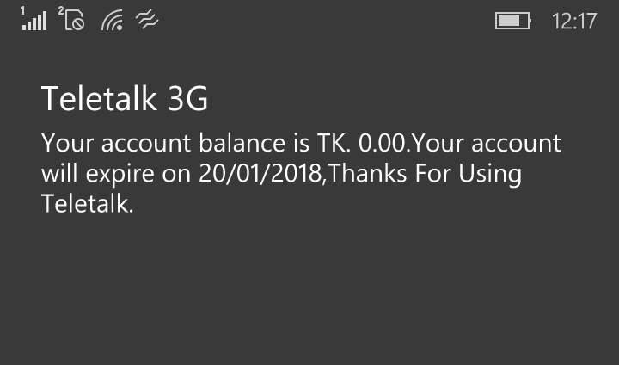
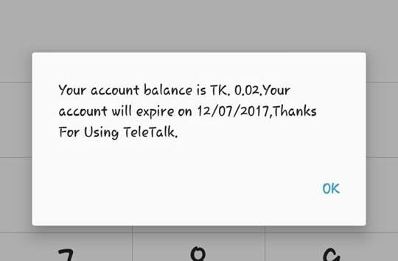
Abstract
But to load balance in different sim cards, systems are not same. Often a picture flashes on our mobile screen! That is…
So to avoid this unwanted situation we can use our Ecommerce,

Slide 5
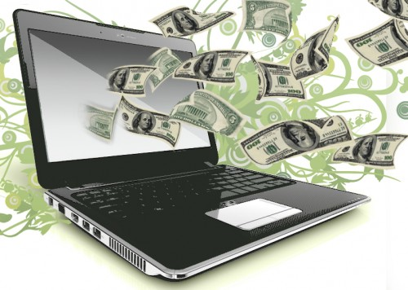
Purpose
In Online Balance flexi load site where the consumer moves through the internet to a web site. From there, he decides that he wants to purchase mobile balance, so he is moved to the online transaction server, where all of the information he gives is encrypted.

Slide 6
Purpose
Once he has placed his order, the information moves through a private gateway to a Processing Network, This generally takes place in no more than 30mins or 1hour.

Slide 7
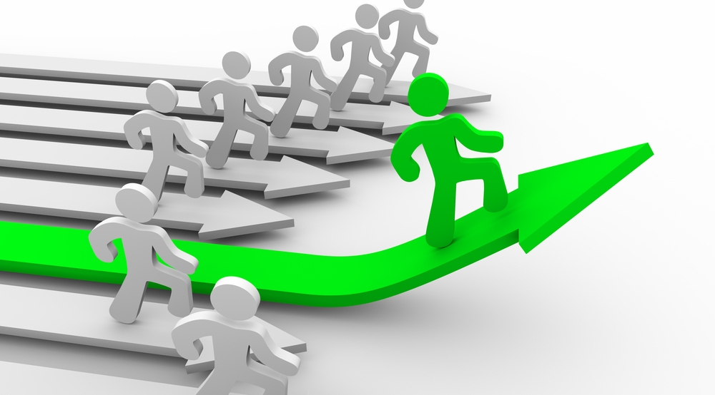
Advantages
24x7 support. Customer can load balance for any amount provided by a company any time, any where from any location. Here 24x7 refers to 24 hours of each seven days of a week.

Slide 8
Advantages
Customers need not to travel to load balance, thus less traffic on road and low air pollution.
Online Flexi load application provides customers more options and quicker delivery of mobile balance at any time.

Slide 9

Disadvantages
Privacy and security. Before making online application for flexi load, must need to check the sites certificates of security.
Sometimes delay in receiving the mobile balance in critical moment.

Slide 10
Disadvantages
Despite of all the disadvantages Online Flexi load System save our time. If we concern about our security system then this system will be very beneficial for us to sustain our communication system and we can go ahead. . .

Slide 11


